Slide 1

SENTIMENT ANALYSIS ON AMAZON REVIEWS
Devashree Shirude
CSCI 561 : Foundations of Artificial Intelligence
(Prof. Sheila Tejada)
USC ID : 7188293637
shirude@usc.edu

Slide 2
Dataset and problem
SENTIMENT ANALYSIS
Sentiment Analysis is the process of determining whether a piece of writing is positive, negative or neutral. It’s also known as opinion mining, deriving the opinion or attitude of a speaker
PROBLEM AND DATASET DESCRIPTION
The Dataset contains about 400,000 Amazon reviews. The aim is to train a model using a machine learning classifier so as to be able to predict the sentiment value for test data(every 5th element of given dataset)
After detailed analysis of the dataset given, it endowed that there were 195061 positive reviews and 195285 negative reviews and the sentiment value was strictly bipolar
DATA PRE-PROCESSING
Countvectorizer method to tokenize the data appropriately(removal of punctuation, special characters, case sensitivity, stop words) as vectors to make it suitable for classification – feature extraction
Using n-grams technique for obtaining higher precision in sentiment factor allocation

Slide 3
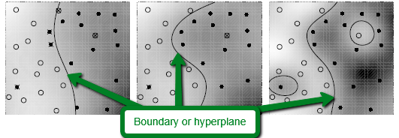
Machine learning classifiers
Neural Networks (Accuracy : 88.98%)
Derives meaning from complicated/imprecise data;
Fault tolerance and self repair
Takes more time; has multiple layers
Random-Forest (Decision Tree) (Accuracy : 78.84%)
Combines several baseline classifiers
Less variance
Reduces overfitting
Support Vector Machine (Accuracy : 87.78%)
Avoids overfitting
Uses kernel trick
Why SVM?
Acknowledgeable accuracy for larger datasets as compared to Naïve Bayes
Minimal requirement of a set of core points(i.e. the support vectors) so as to set the hyperplane as compared to Regression

Slide 4
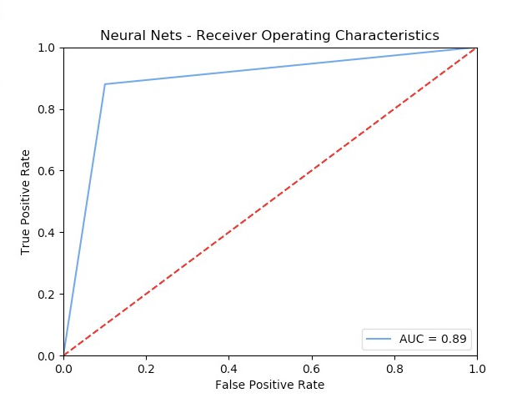
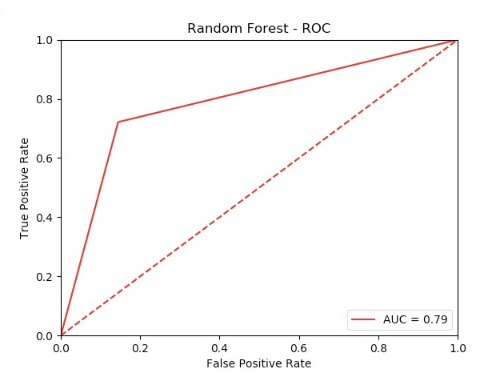
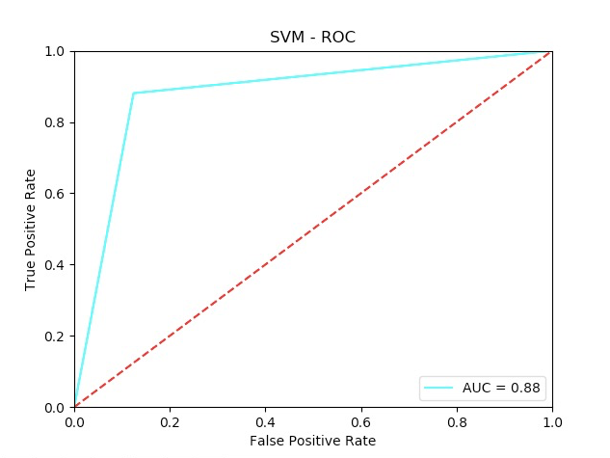
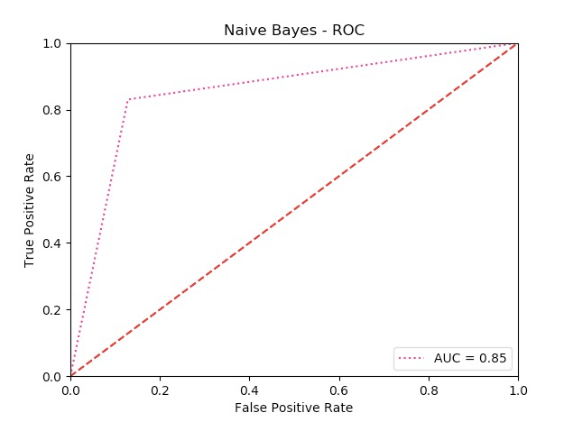
Classifier Results’ Visualizations

Slide 5
Classifier Results’ Visualizations

Slide 6
Thank You

